Slide 1
Experience Design System
The UX team at Viasat had launched a beta version of the XDS (Viasat’s design system. The system consisted of the 10 patterns (form, wizard, navigation, etc.), digital style guide, and information about various services offered by the UX team.
The team’s vision for the design system was to:
Create a robust design system based on the Atomic design principles of Brad Frost.
Make XDS community driven i.e. allow developers and designers to submit and host unique components and patterns on XDS

Slide 2
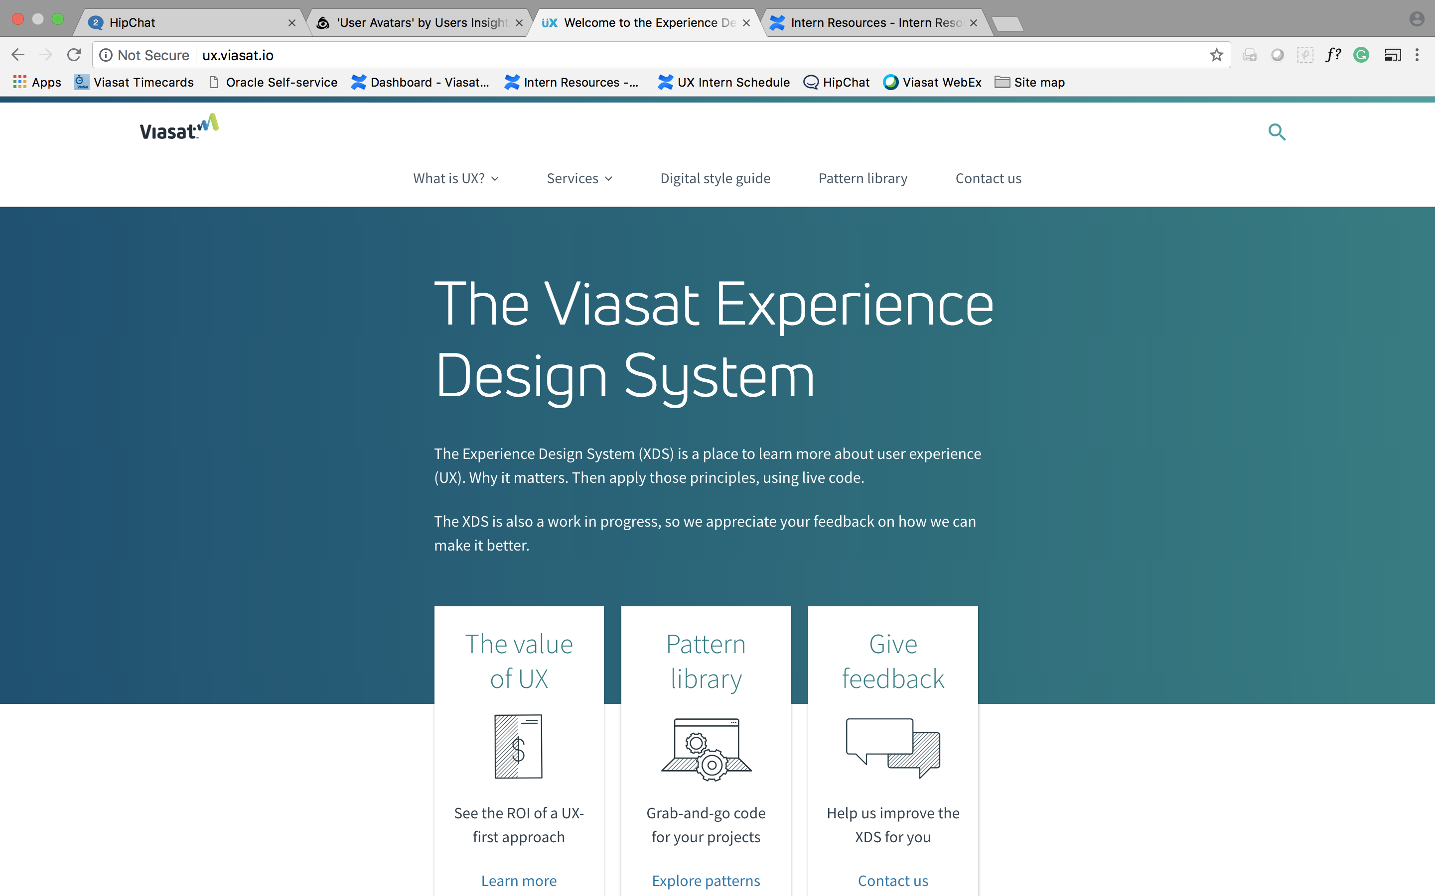
Experience Design System (XDS)
Goals
Assess and expand XDS
Make XDS scalable (community driven)
Objectives
Understand the users mental model of pattern libraries
Create a list of components to be included in XDS
Identify gaps
Improve the usability of XDS
Notes:
- XDS is our design system
- that’s the beta version of the XDS that was released this may

Slide 3


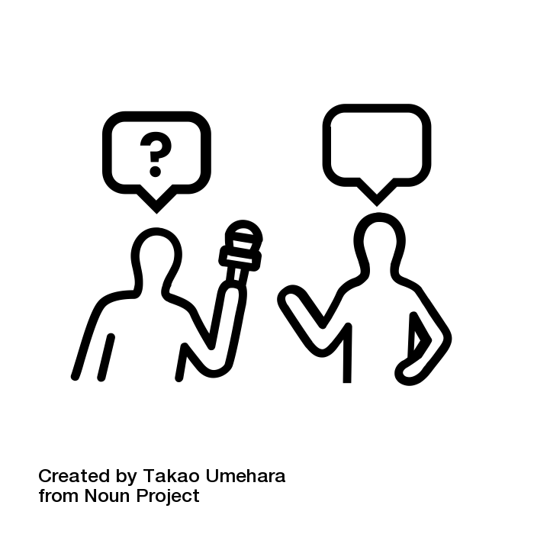
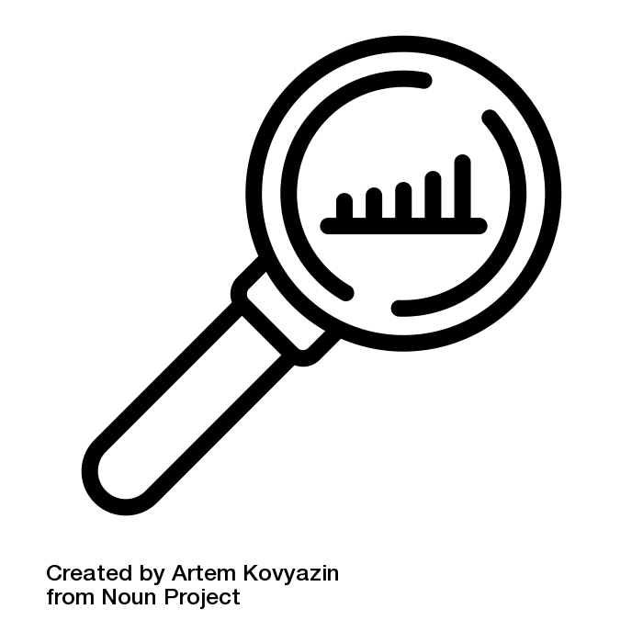
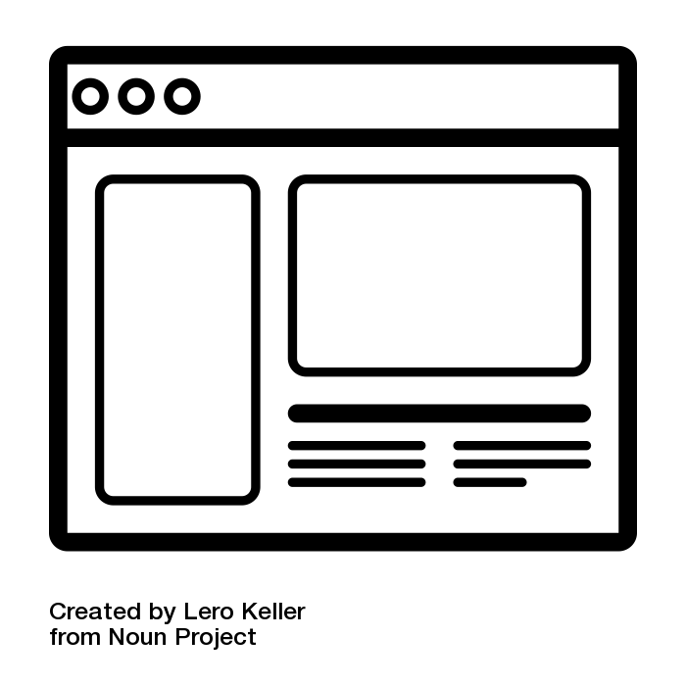
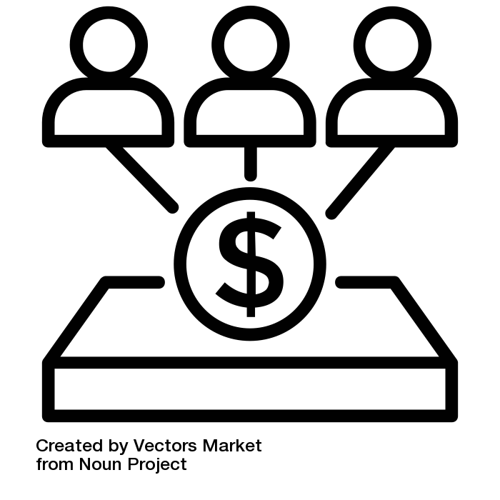
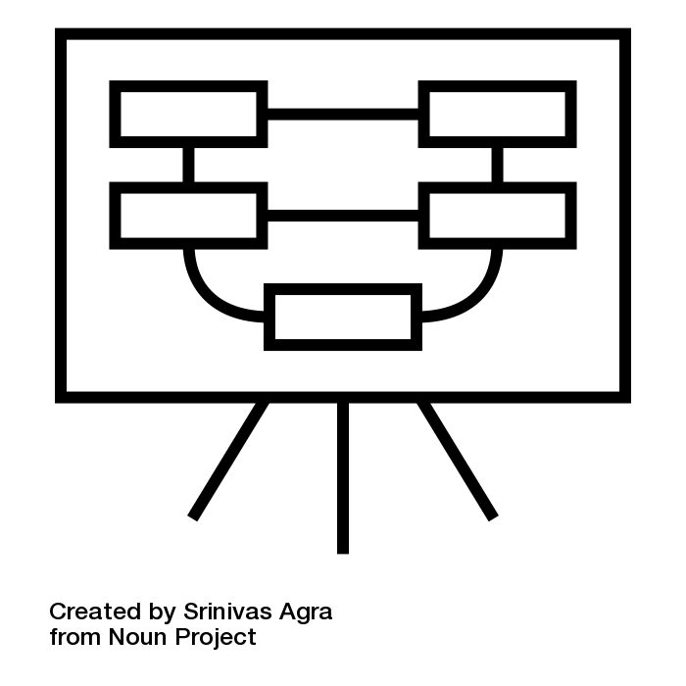
Process An iterative and collaborative process was followed. User research and stakeholder inputs were involved at every step.
Step 1
Step 2
Step 3
Step 4
Step 5
Step 6
Literature & Product Research
Stakeholder
interviews
User
Research
Gap
Analysis
Information Architecture
Wireframes & Prototypes
Book
Articles/papers
Examples
Videos
Product walkthrough
Requirements
Tribal knowledge
Past research
User interviews
Card sorting
Persona
Components
Standards
Devices
Content
Personas
User research
Analogous experiences
Power point
Sketch
XD
Notes:
Not linear fashion
Iterative
collaborative

Slide 4
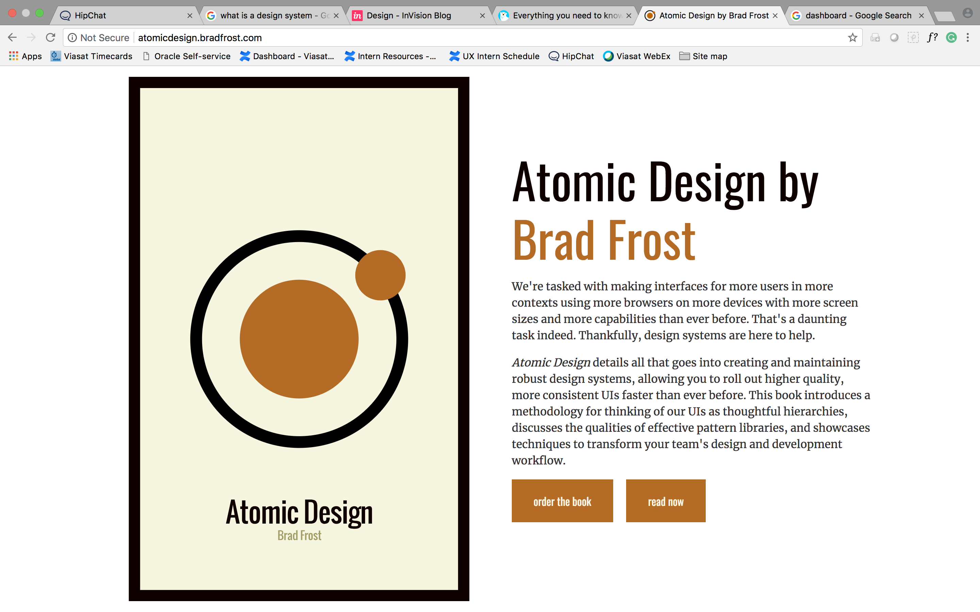
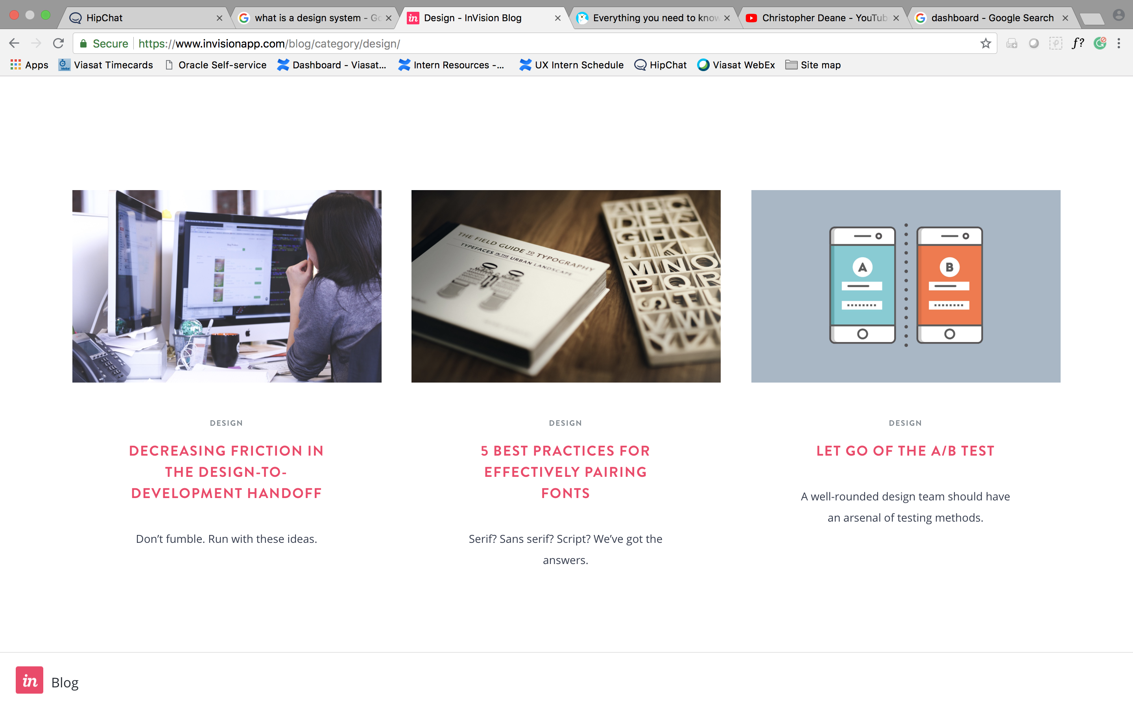
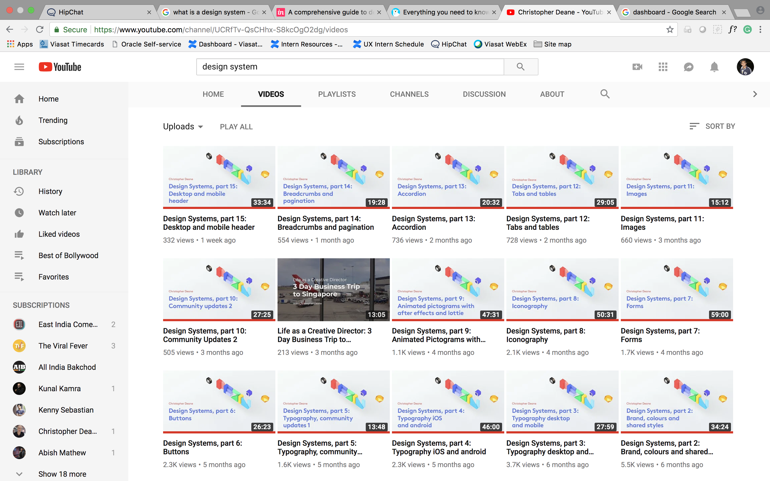
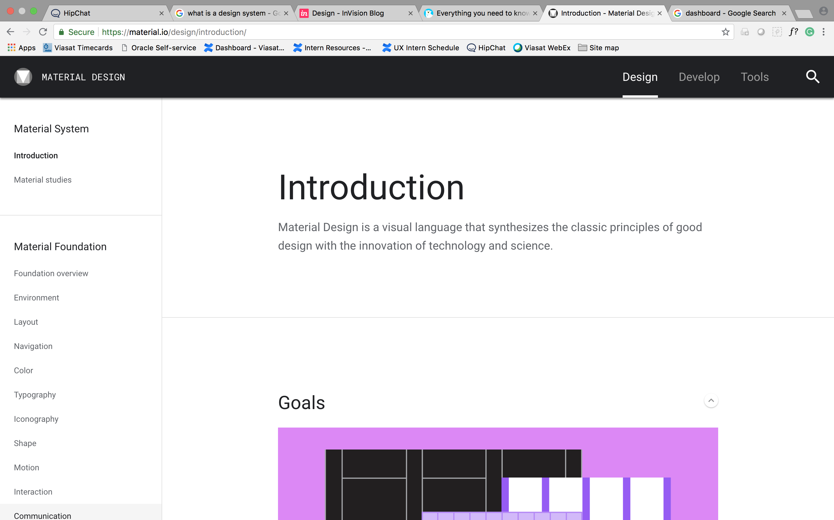
Step 1: Literature & Product Research
Books
Articles
Videos
Examples

Slide 5
Step 2: Stakeholder Interviews
Spent time with each discipline to understand the system from their point of view. Stakeholder interviews were also used as requirement gathering tools.
Kaitlin
UX Research
Jaime
UX Design
Jaime
Content Strategy
Tara
Visual Design
Gary
Front-End

Slide 6
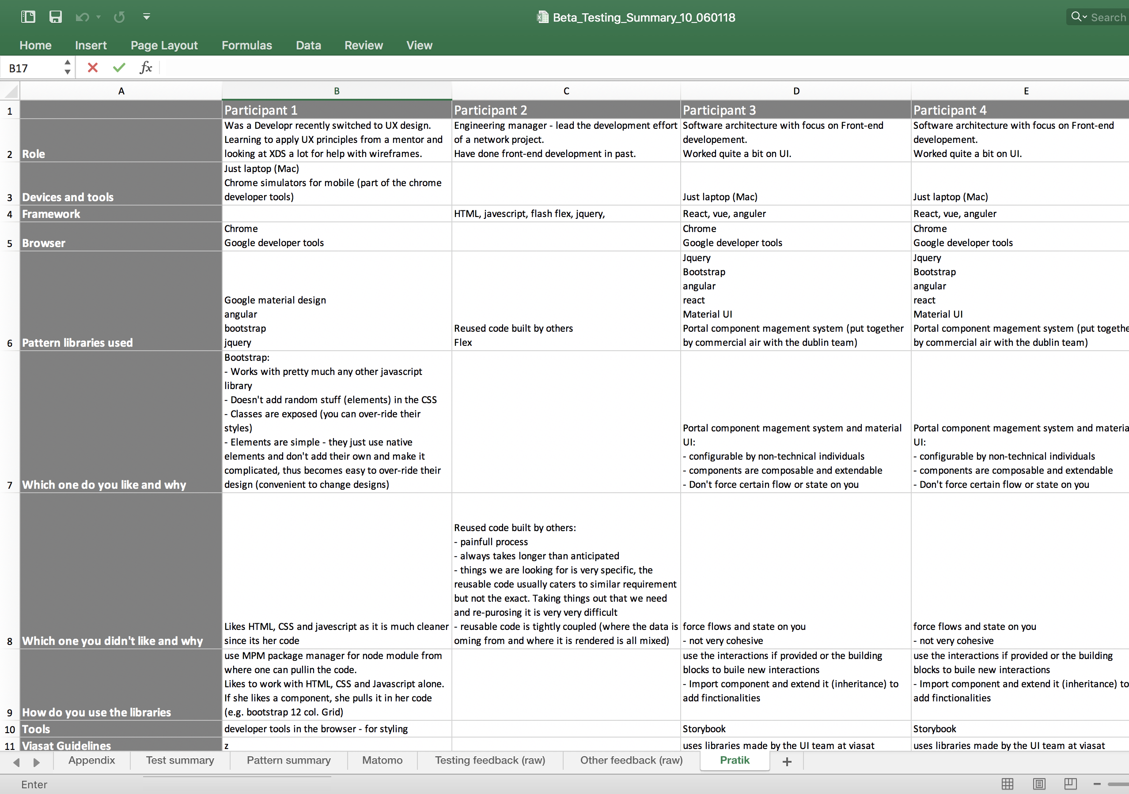
Step 3: User Research - Interviews
Created a moderator’s guide
Recruited users with the help of the UX team
Conducted user interviews with
1 Software Architect
1 Dev/UX Design
1 Engineering Manager
1 UX Designer
4 Interns
Captured results and insights
Updated persona and designs of component pages

Slide 7
Step 4: Gap Analysis (What’s missing?)
Gaps were identified based on literature , online research, user research , stakeholder interviews, and walkthroughs and demonstrations of various Viasat products
Grab and go assets
Guidelines
Services
Good to have
Framework specific (React, angular, etc.) code
Wireframes for component and patterns
Visual mockups for component and patterns
Templates for various research studies
Accessibility criteria for all components and patterns
Guidelines for white label products
Content guidelines
Research guidelines
Accessibility guidelines
Coding guidelines
Designing for devices other than Desktop
Language translation guide (internalization)
Educating and helping through the design process (what we are doing with ATG)
Collaborating with other teams (UX partners)
Making teams sustainable (XDS)
UX Processes
View ports
Educational pieces
Case studies
Blogs
White/grey Paper
Fact cards (https://uxdcards.com/cards)
Statistics repository, Did you know, Infographics
Notes:
Must have and good to have
Grab and go assets (assets more that just code)
Guidelines, not just regarding how to use code, but also about
how to do research
how to write for digital
Language translation
White label products
How to design for devices other that desktop

Slide 8
Step 4.1: Component & Pattern Creation
Buttons
Text button
Outlined button
Contained button
Toggle Buttons
Dropdowns
Regular dropdown
Multi-select dropdown
Radio buttons
Check boxes
Input fields
Text box
Text Box Auto suggest
Text area
Numeric stepper
Date & time picker
Switch
Tags (Chips)
Captcha
Sliders
Discrete
Continuous
Horizontal global navigation
Mega menu
Navigation list
Navigation tree
Links
Regular links
Anchor links
External links
Search
Pagination
Breadcrumbs
Bar Chart
Vertical
Horizontal
Multi-set
Stacked Column
Line Chart
Single variable
Multiple variable
Pie Chart
Pie
Donut
Area Chart
Single area
Stacked area
Choropleth
Scatterplot
Bubble graph
Tables
Regular Tables
Data Tables
Expandable tables
List
Regular List
Expandable List
Bookmark tabs
Accordion
Carousel
Pop-up
Message box
Toast/Snack bar
Notification
Progress bar
Step indicator
Tooltip
Weather
Errors & Warnings
Colors
Fonts
Icons
Illustrations
Images
Logo
Notes:
- Came up with a list of 46 must have components and patterns

Slide 9
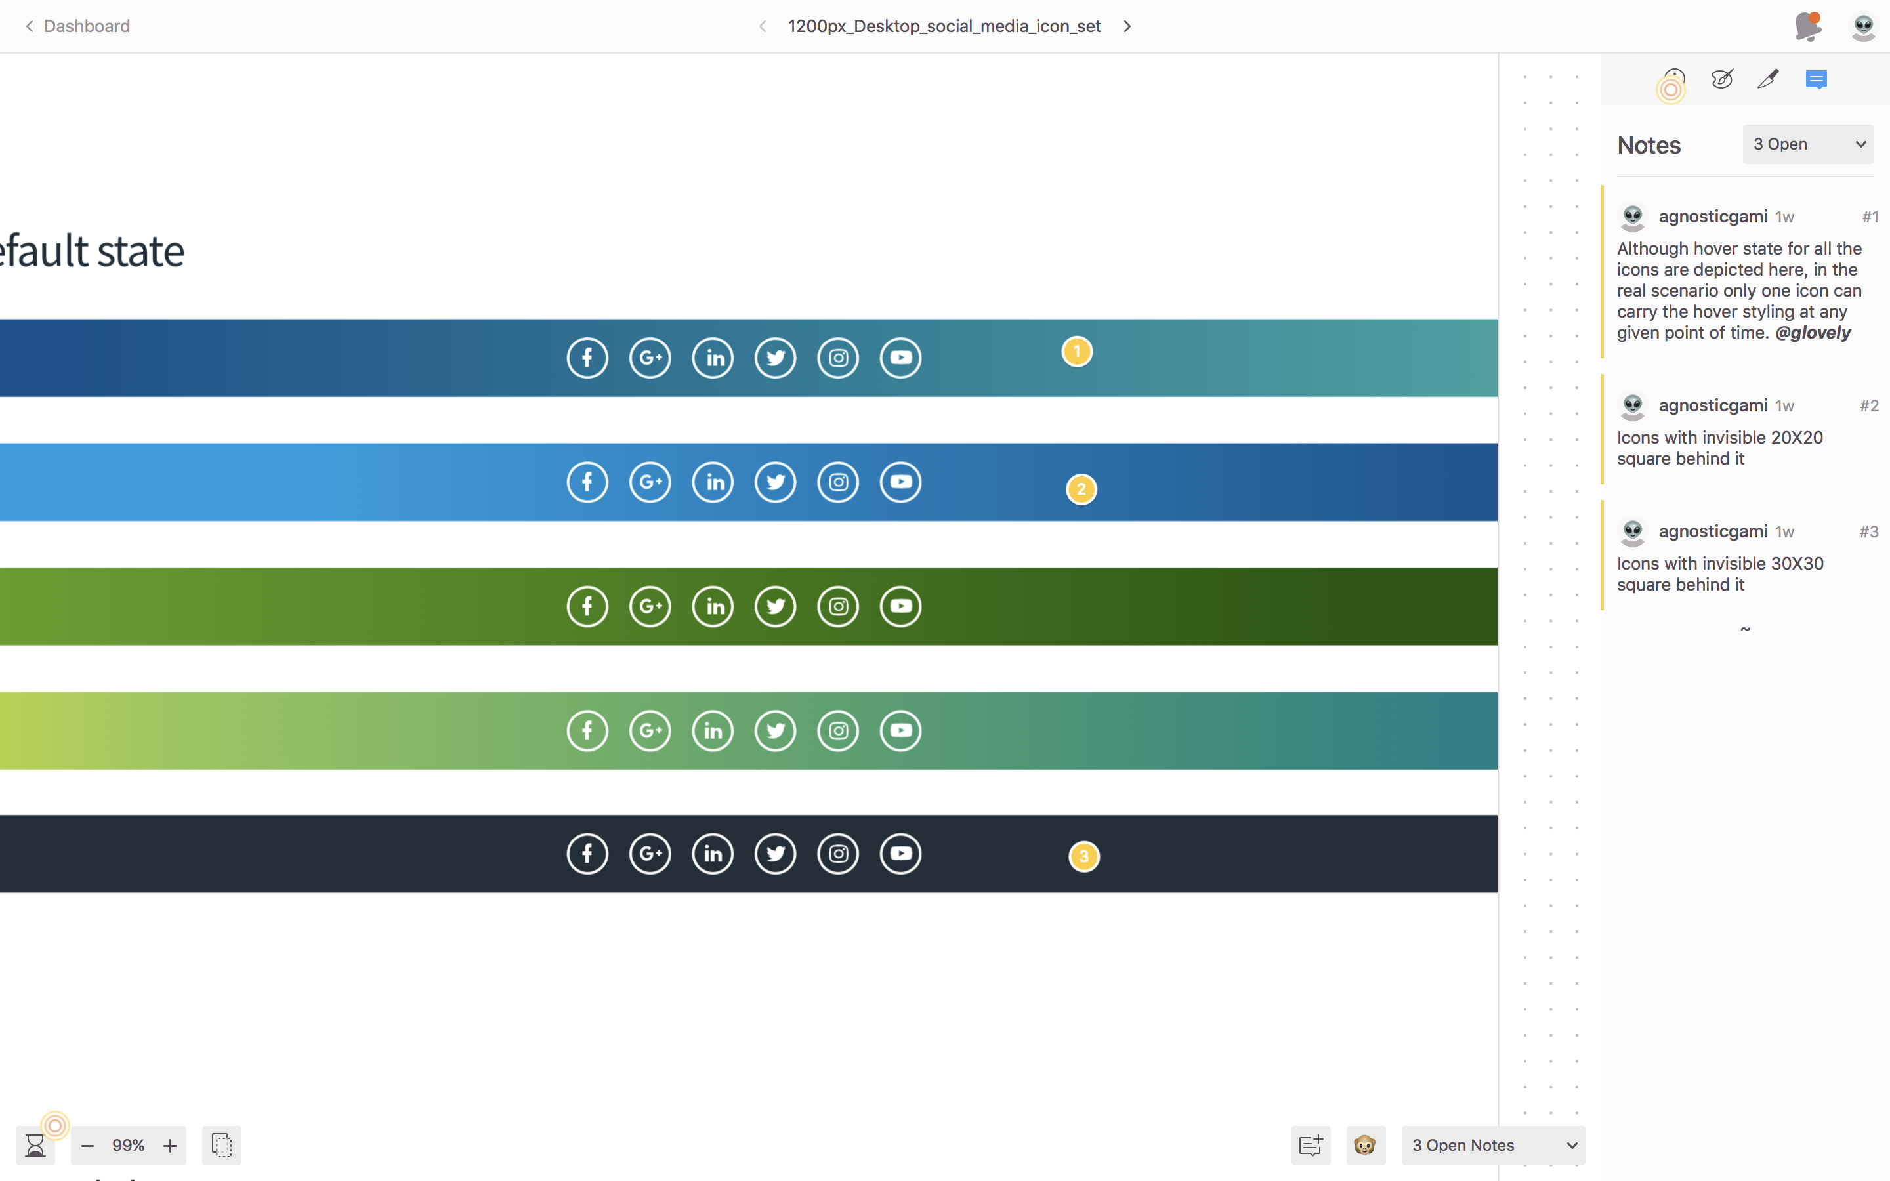
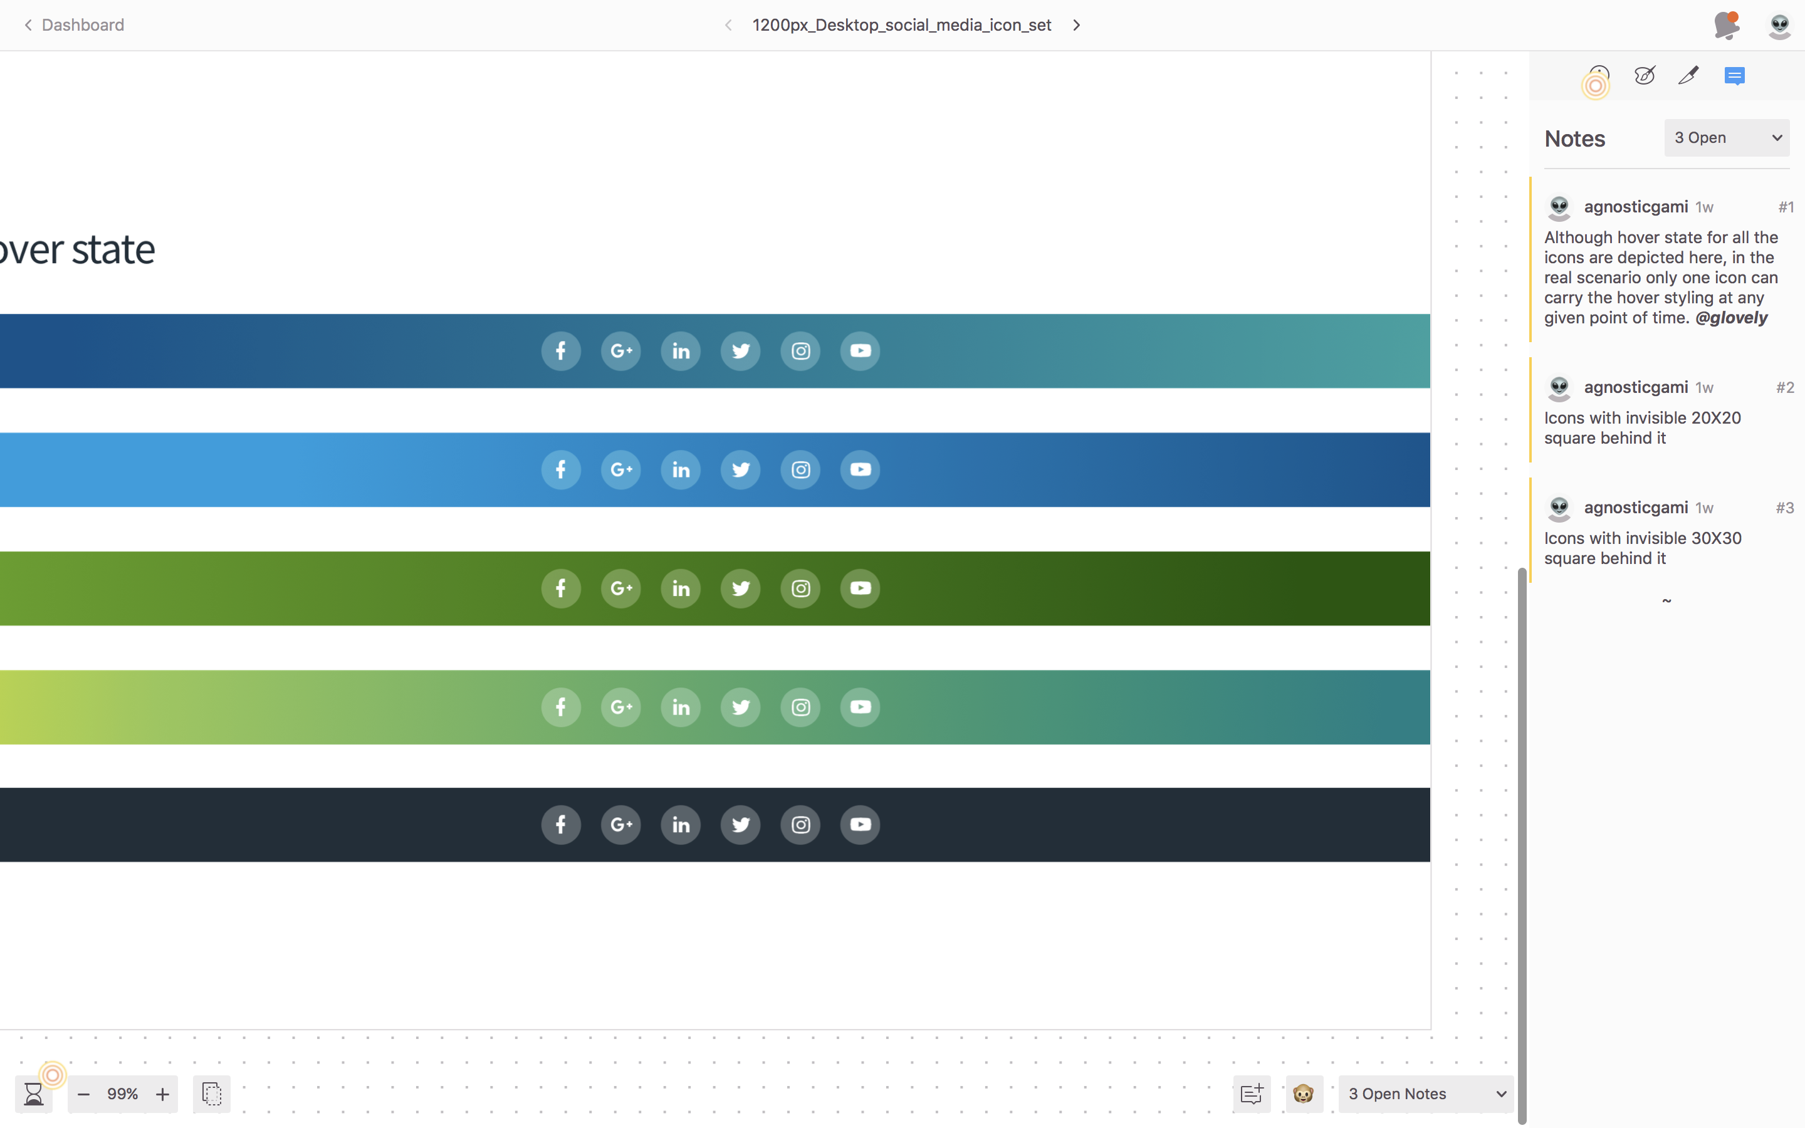
Step 4.2: Icon creation
I had shared my desire to step into visual design before the start of my internship. My team gave me this opportunity and I thoroughly enjoyed it.
I designed social media icons for Viasat website. The process involved finding and understanding the specs and logo usage for each social media giant
It helped me realize how intricate and detailed the job of a visual designer is. This is important because as a UX practitioner, our job is not only to emphasize with our users, but, our co-workers as well.
In the process of learning, I discovered few things (to be more precise 1), that my team was not aware of.

Slide 10
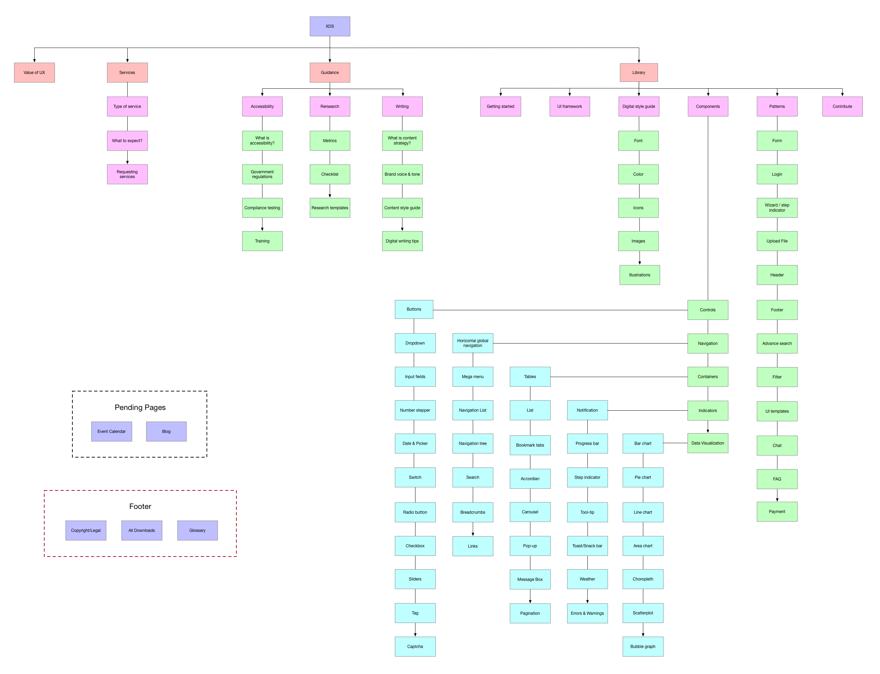
Step 5: Information Architecture
IA was created based on:
Existing design systems and pattern libraries like material design, bootstrap, etc.
User research
Stake holder interviews
Walkthroughs and demonstrations of various Viasat products
Each element of IA was discussed and deliberated upon by the UX team (research, interaction, visual, content, and front-end)
Notes:
- Built the IA based on the use research, domain research and stakeholder interview

Slide 11
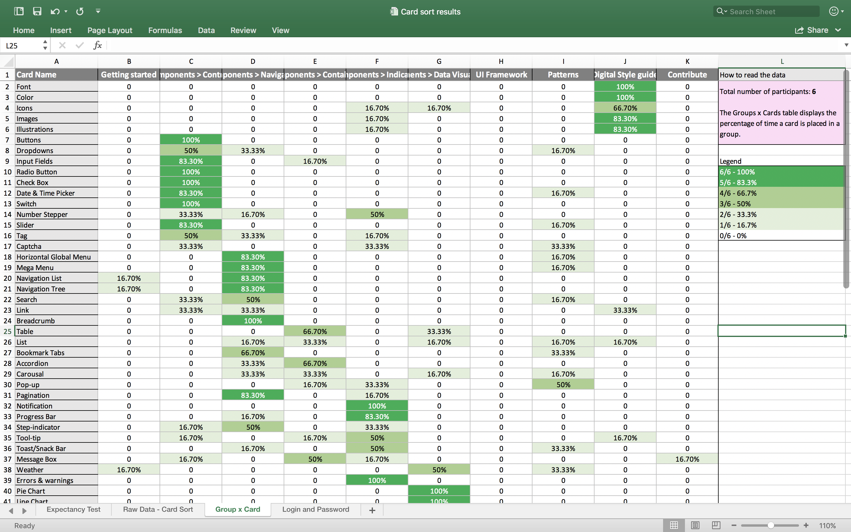
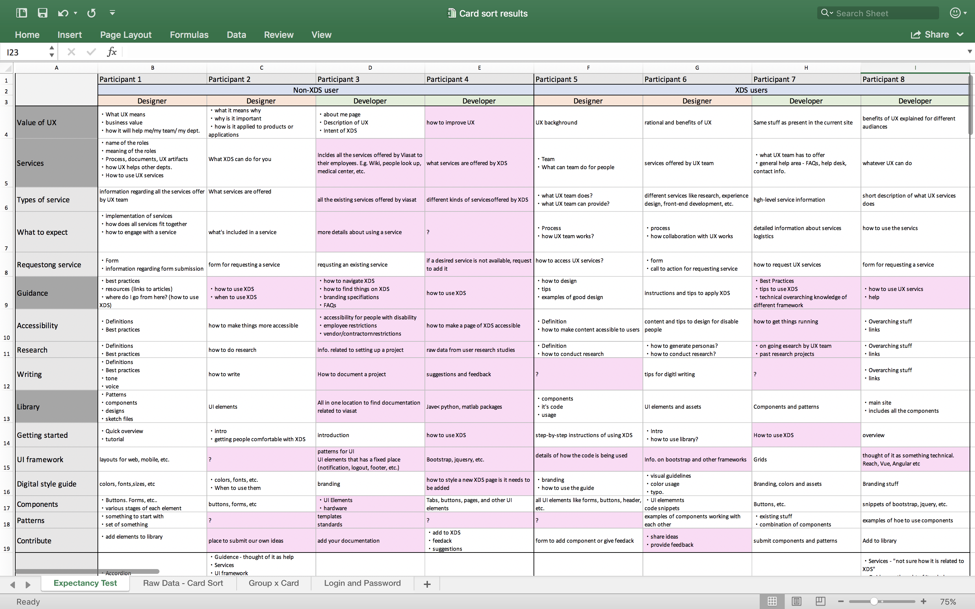
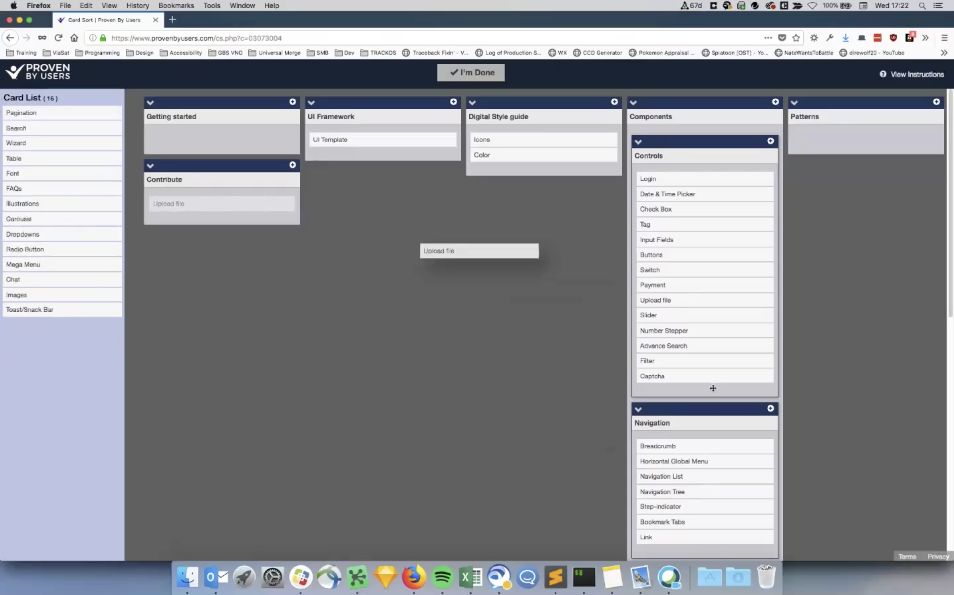
Step 5.1: User Research – Card Sort
Optimized IA was created based on Card sorting results
Group vs Cards
Expectancy test
Card sorting tool
Notes:
- Tested the IA with the users

Slide 12
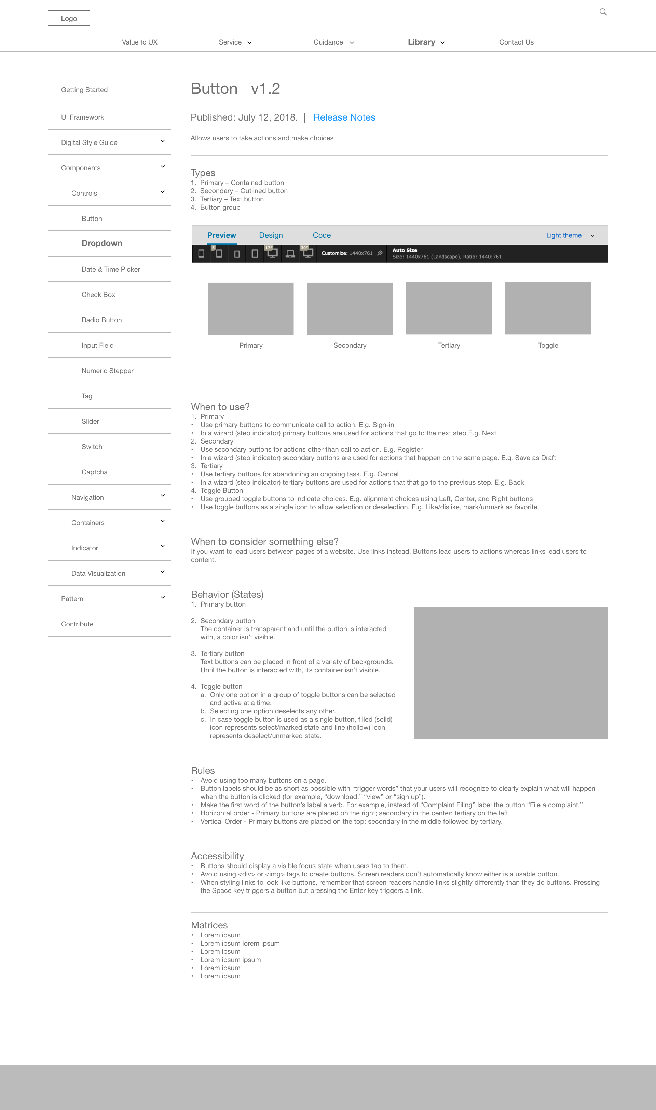
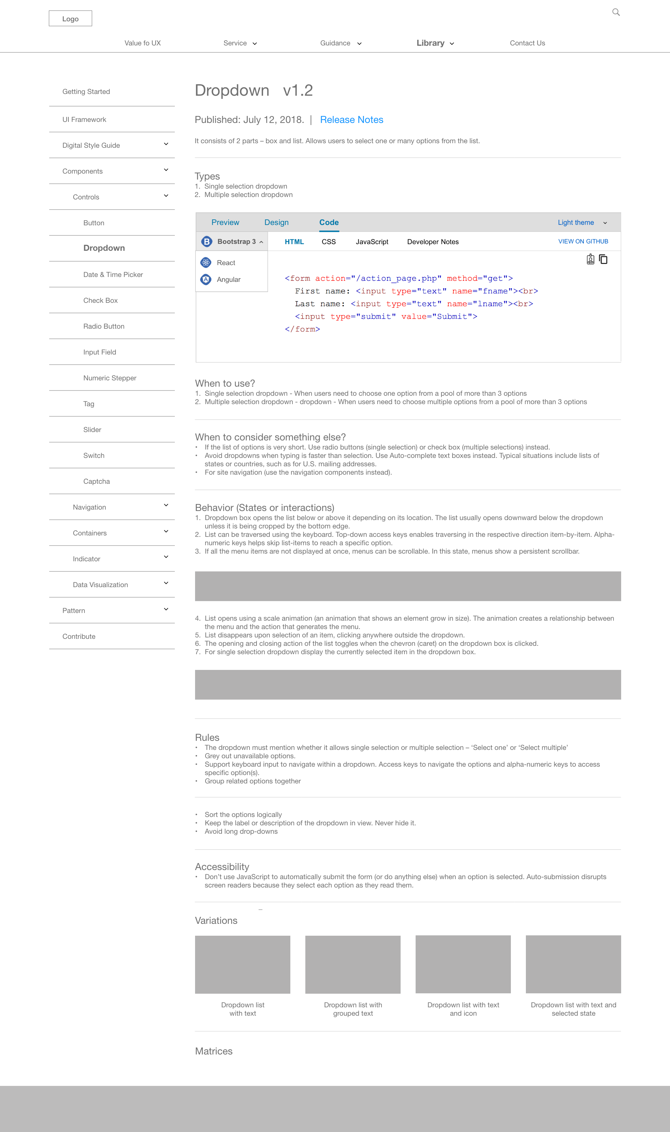
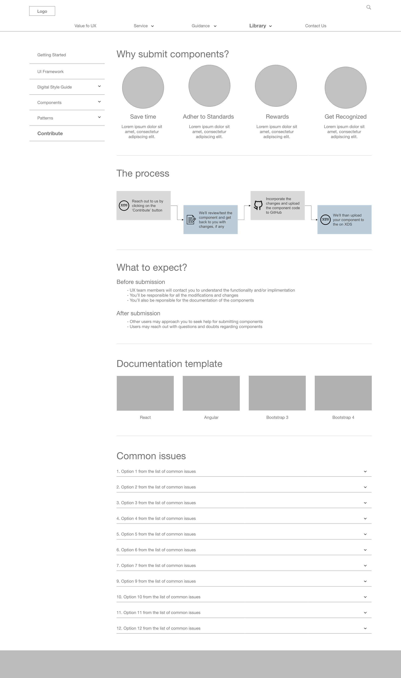
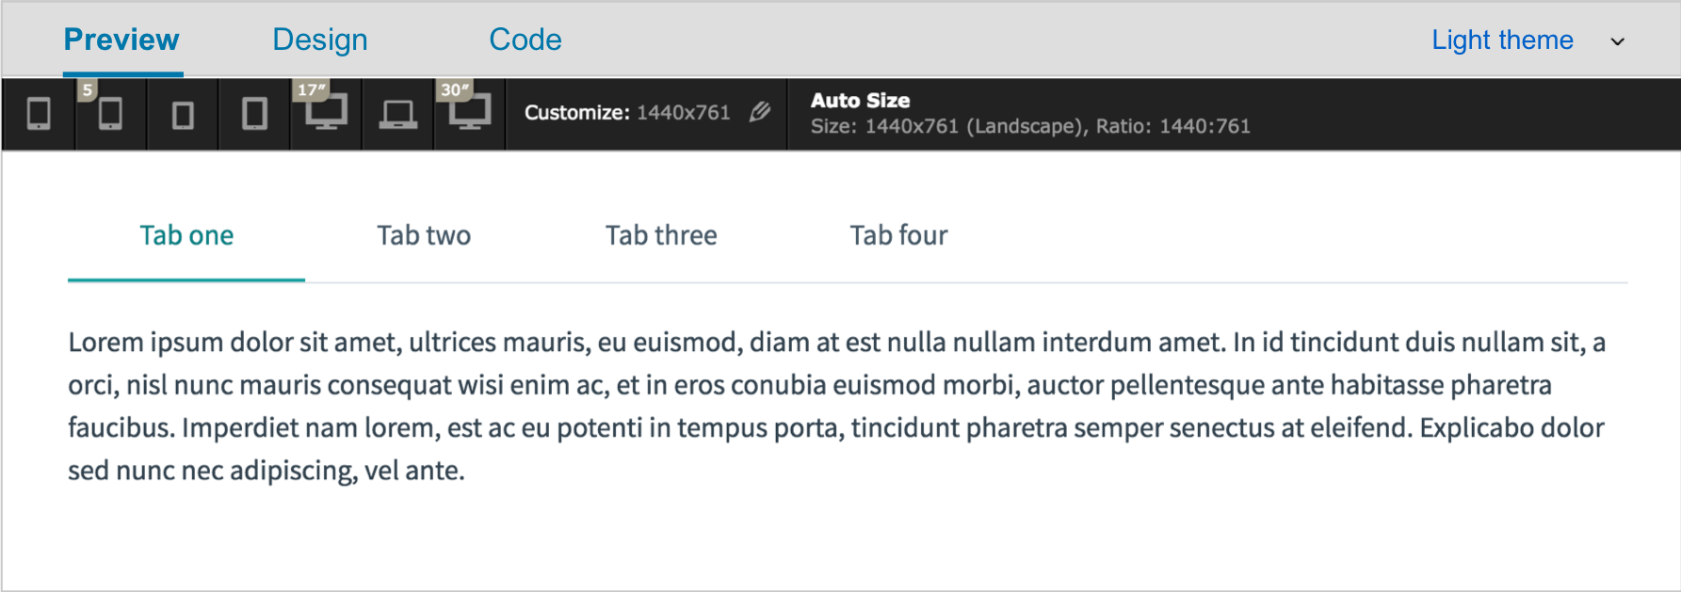
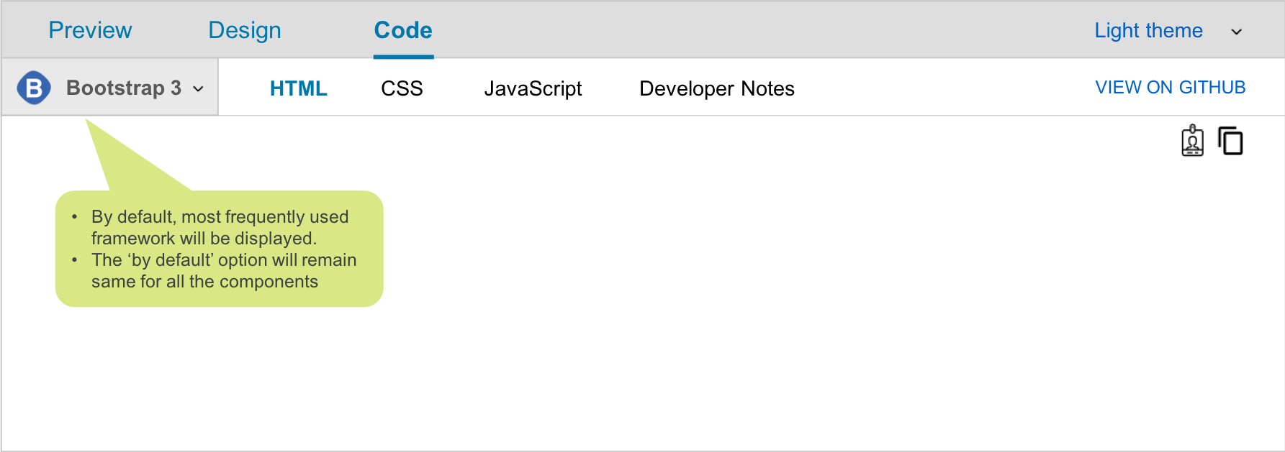
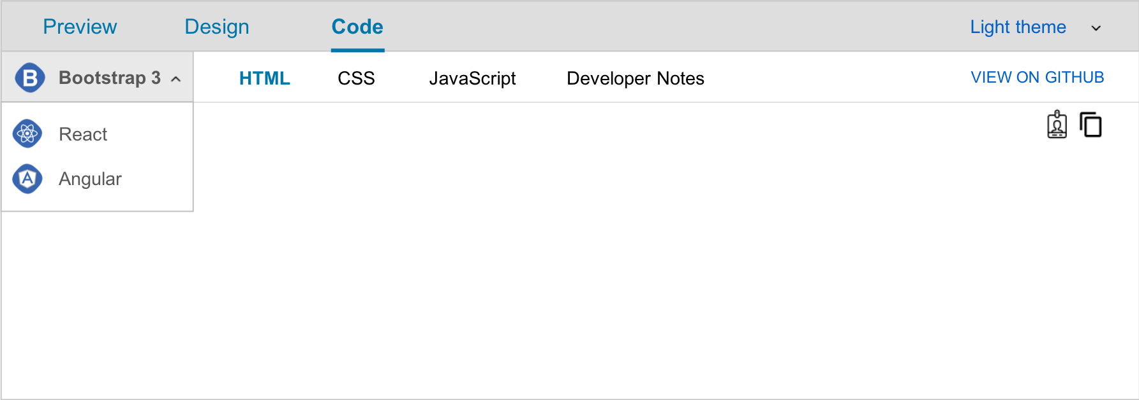
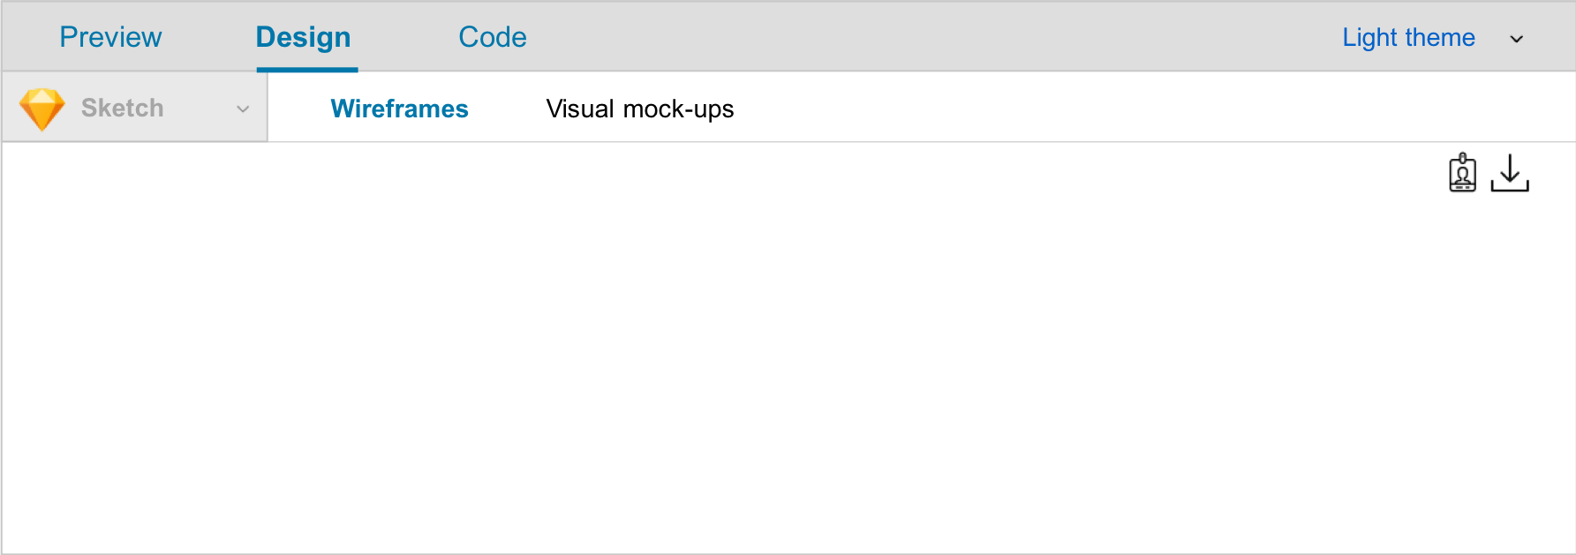
Step 6: Wireframes
Created wireframes of unique pages based on user interview insights
Documented ideas and strategies for future implementation and release of XDS
Notes:
- Key page elements and their location
Header
Footer
Navigation (global and local)
Content objects
Call to actions
- Grouping of elements
- Hierarchy of elements
Labeling, page title, navigation links, and headings to content objects
Place holders for content and images.
It does not include
- Colors
- Fonts
- Logos
- Images

